Slide 1
前端MVC初探
EricHua
2012年12月15日
我知道的不多, 但我分享我知道的所有, 包括错的

Slide 2
开篇
那些熟悉的面条式的代码
那些写完再写不复用的代码
那些缩进到18层的代码

Slide 3
Change is needed
前端MVC是趋势
趋势从何而来?
前端工程师应该做出那些改变?
他能给我们带来什么?
Show me the code!!!!(实战)

Slide 4


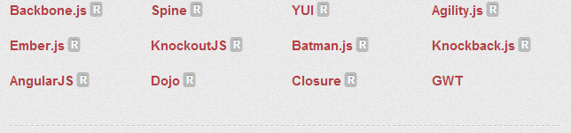

前端MVC是趋势
foursquare

Slide 5
趋势从何而来? 我们经历了多少分离

Slide 6
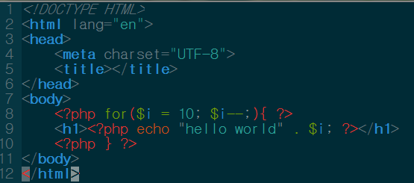
很久以前

Slide 7
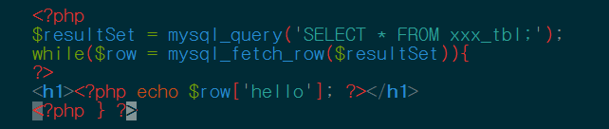
…… 过了很长时间
我们需要用数据库保存信息
Notes:
查询增多…..

Slide 8
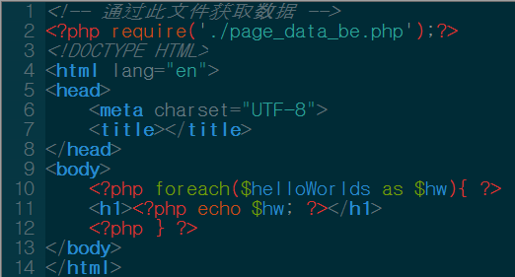
复杂数据处理分离

Slide 9
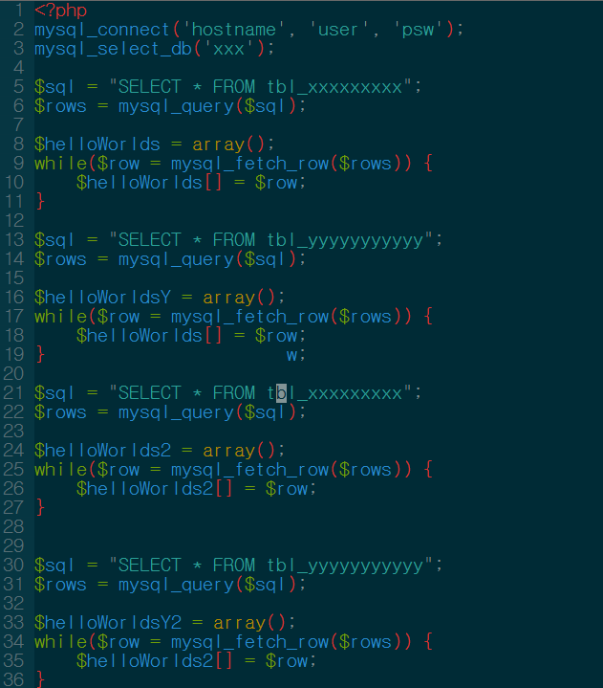
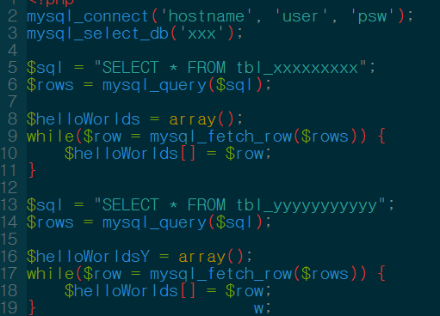

Slide 10
扩展!!!!(痛苦)
改!!!!(哭)

Slide 11
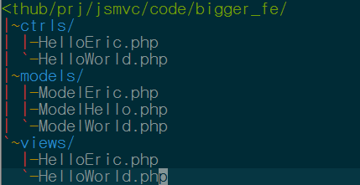
分离的时候到了!!

Slide 12
PHP工程师开始过着快乐的日子

Slide 13
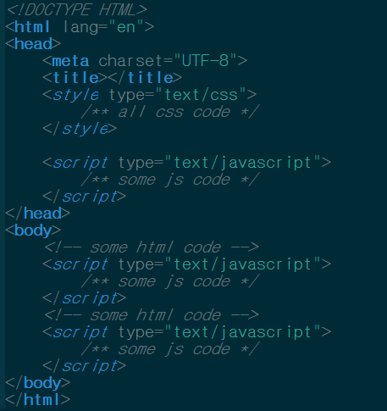
JavaScript工程师呢?

Slide 14
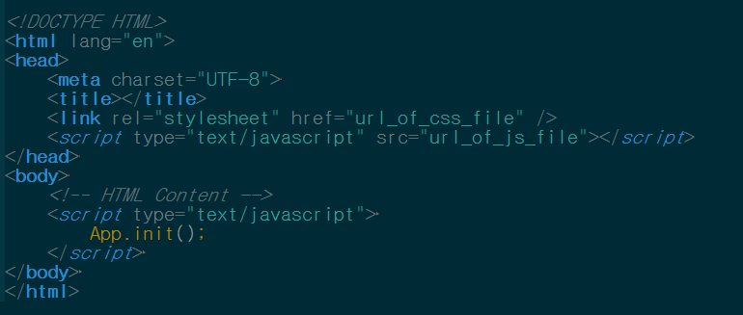
分离!!!!

Slide 15
以后
有专人写CSS
有专人写HTML
JavaScript工程师过着快乐的日子

Slide 16
突然, 小马哥说: 一切以用户价值为依归 要注重用户体验

Slide 17
用户体验? 良好的视觉设计,良好的交互设计, 响应要快
经常刷新页面不可为之快, 使用Ajax, 或者我们直接使用单页面应用吧.

Slide 18
从此JavaScript工程师的快乐时光结束, 他们开始写着比HTML/CSS/PHP工程师都多的代码 他们开始经常在一千多行的文件中跳转. 他们的世界开始变得混乱……

Slide 19
混乱在于何处
$(‘button’).bind(‘click’, function(){
$.ajax({
url: ‘http://www.somesite.com/getX’,
success: function (data){
$(“#x-container”).html(data);
}
});
});
不厌其烦的写着这样的代码
可能的问题: 这样的面条代码, 没法分开, 难以复用, 一般情况, success里面会很多东西, 或者在里面还可能嵌套更多成同样的代码.
Notes:
这段代码做了写什么呢?
绑定事件
获取数据
更新显示
简单的一段代码做了控制器, 模型, 视图三者的工作

Slide 20
前端工程师呢?

Slide 21
MVC
MV(C) backbone
M(V)C spinejs
M(VC) VC共同存在

Slide 22
MVC结构图(传统MVC)

Slide 23
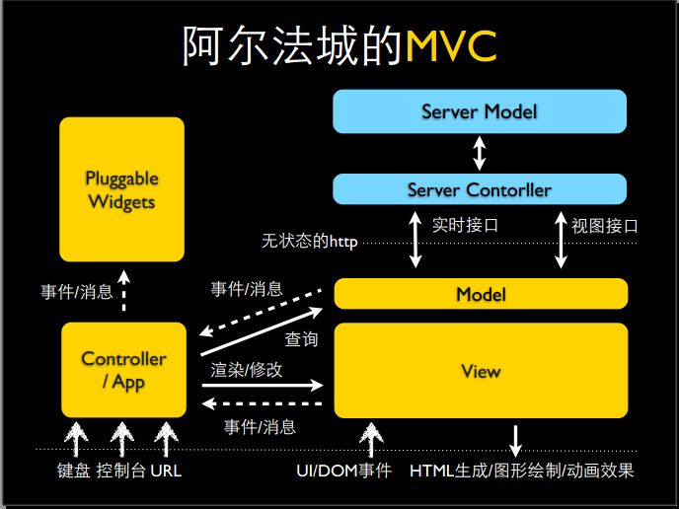
MVC结构图(豆瓣阿尔法城)

Slide 24
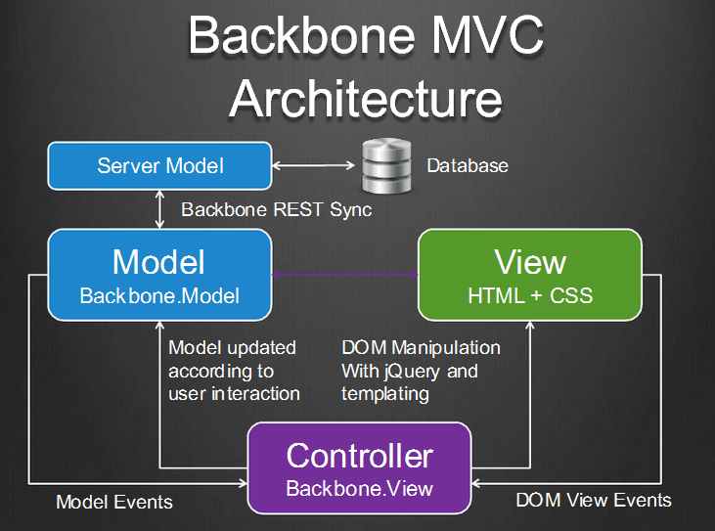
Backbone MVC结构

Slide 25
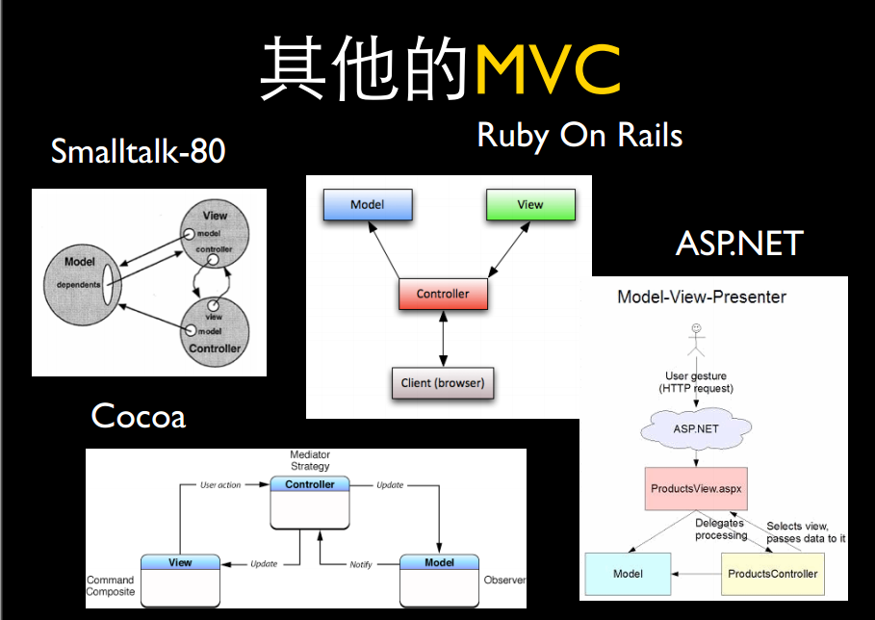

Slide 26
Backbone
Backbone.js gives structure to web applications by providing models with key-value binding and custom events, collections with a rich API of enumerable functions,views with declarative event handling, and connects it all to your existing API over a RESTful JSON interface.
只有唯一的强依赖:underscore

Slide 27


Events(基础)
需要接受和触发事件的对象都继承自它.
两个核心方法:
object.on(event, callback, [context])
object.off([event], [callback], [context])

Slide 28
Events(基础)
trigger(event, [*args])
once(event, callback, [context])
listenTo(other, event, callback)

Slide 29
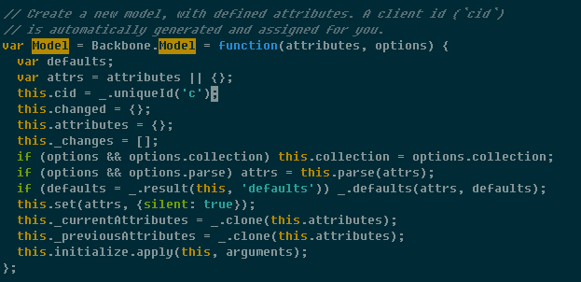
Model(核心)

Slide 30
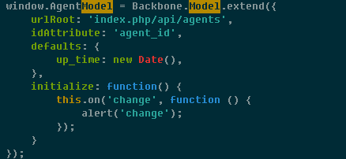
Model(核心)
新建一个Model
defaults 默认属性值
urlRoot fetch时从此url获取数据填充model
Initialize 在new Model完成以后自动调用

Slide 31
Model
model.set(attributes, [options])
model.get(attribute)
model.fetch([options])
model.save([attributes], [options])
model.destroy([options])
model.validate(attributes)
model.change() 不想每次set都出发change事件,可以再set处{silent: true}, 之后在手动用此方法出发change事件

Slide 32
Collection
Collections are ordered sets of models. You can bind "change" events to be notified when any model in the collection has been modified, listen for "add" and "remove" events, fetch the collection from the server
Any event that is triggered on a model in a collection will also be triggered on the collection directly. This allows you to listen for changes to specific attributes in any model in a collection

Slide 33
Collection
collection.model
collection.add(models, [options])
collection.remove(models, [options])
collection.url or collection.url()
collection.fetch([options])

Slide 34
View
Backbone views are almost more convention than they are code — they don't determine anything about your HTML or CSS for you, and can be used with any JavaScript templating library. The general idea is to organize your interface into logical views, backed by models, each of which can be updated independently when the model changes, without having to redraw the page. Instead of digging into a JSON object, looking up an element in the DOM, and updating the HTML by hand, you can bind your view's render function to the model's "change" event — and now everywhere that model data is displayed in the UI, it is always immediately up to date.

Slide 35
view.el
this.el is created from the view's tagName, className, id and attributes properties
view.$el
view.render()
view.remove()
undelegateEvents()

Slide 36
Backbone.sync
Backbone.sync is the function that Backbone calls every time it attempts to read or save a model to the server. By default, it uses (jQuery/Zepto).ajax to make a RESTful JSON request and returns a jqXHR. You can override it in order to use a different persistence strategy, such as WebSockets, XML transport, or Local Storage.

Slide 37
Route

